Slide 1
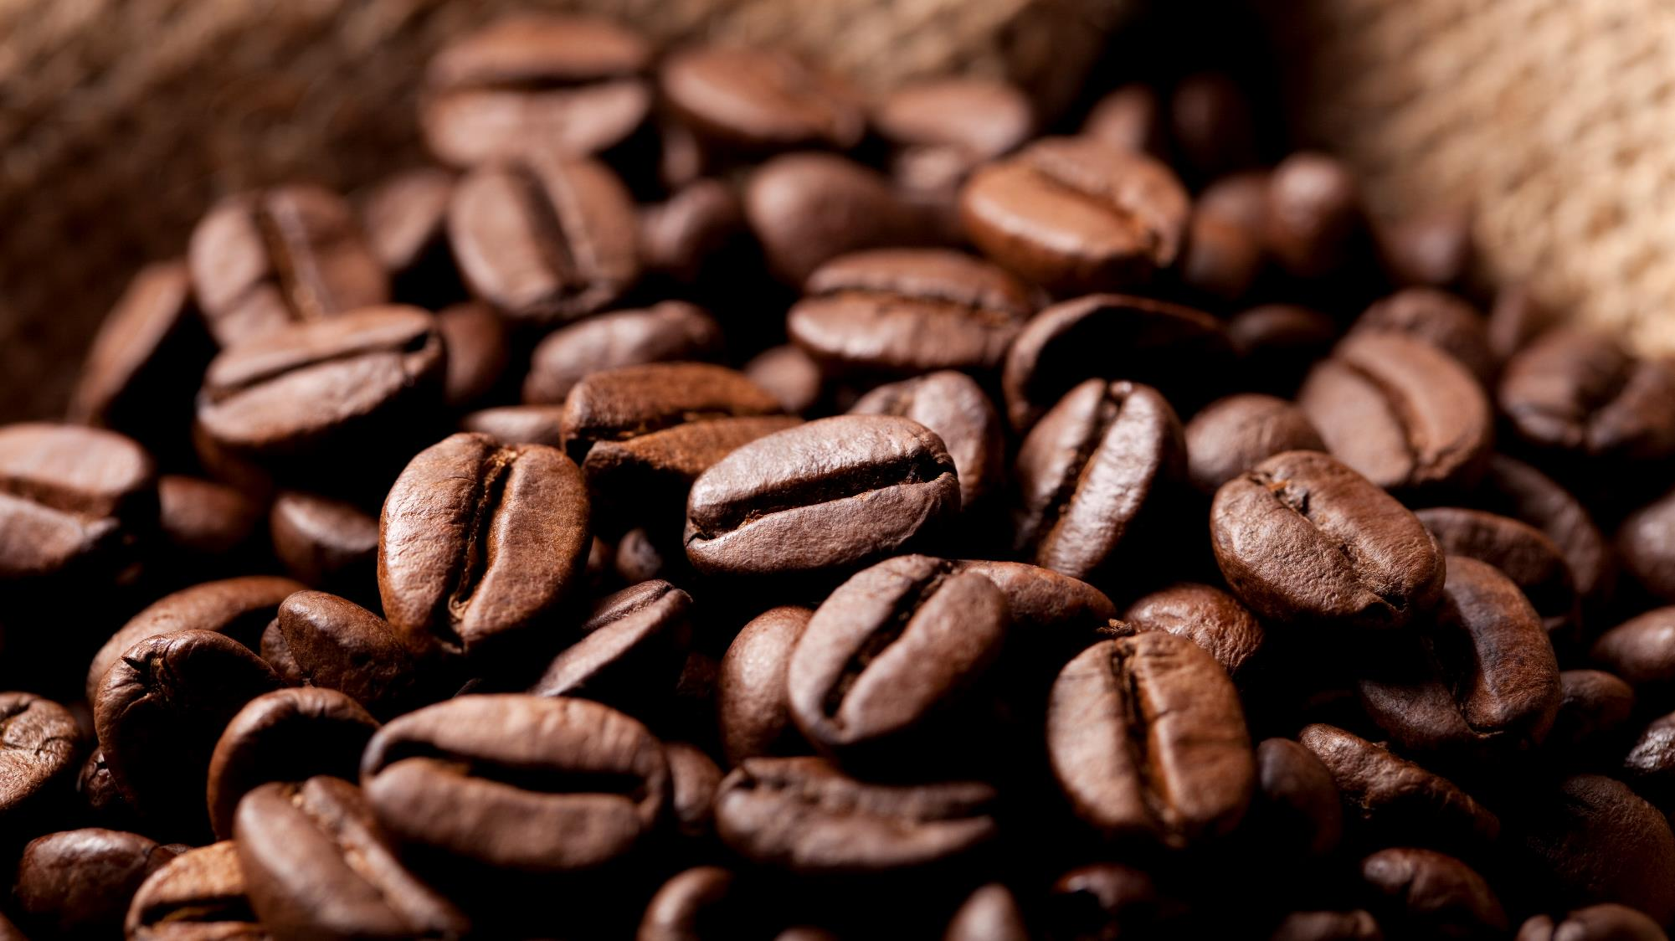
CAFE Table RESERVATION system
JAVA MICROSERVICES RLL-GROUP 2

Slide 2
Team members
ID | NAMES | GROUP
2563779 | Shalini C (Team Lead) | 2
2564330 | Ahmad Zaid | 2
2563745 | Avula Reddy Prasad | 2
2563659 | Akshatha N R | 2
2564229 | Chowdam Baby Sivani | 2
2563951 | Kopparapu Venkata Siva Sankar | 2
2563241 | Lavanya S | 2
2563643 | Narige Navya | 2
2564021 | Pasupuleti Vinay Kumar | 2
2563631 | Sidde Bharath Kumar Reddy | 2

Slide 3
Agenda
Introduction
Objectives
Tools and Technologies
Spring Boot
Microservices (Spring Cloud Config server, Spring Cloud Netflix Eureka, Feign, Resilience4j, Sleuth and Zipkin)
Conclusion

Slide 4
Introduction
In the fast-paced world of today, people are constantly seeking convenient and efficient ways to dine out and enjoy their favorite meals at cafes and restaurants.
The traditional method of making table reservations and interacting with cafes is evolving towards a more digital and user-friendly experience.
To cater to this growing demand, our project aims to develop a modern and robust "Cafe Table Reservation System."

Slide 5
Objectives
The primary objective of this project is to create a comprehensive Backend RESTful Web Services infrastructure to power the Cafe Table Reservation System.
Leveraging Java Microservice architecture, Spring Boot, Spring Cloud, and Spring Data JPA, we intend to build a highly scalable, responsive, and reliable platform for both cafe administrators and end users.

Slide 6

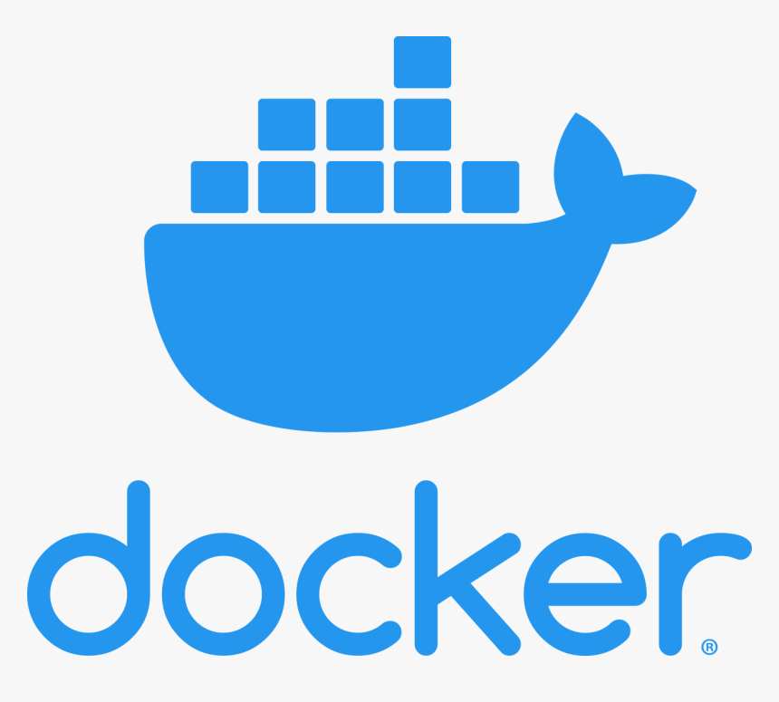





Tools and Technologies
Spring Cloud: Spring Cloud Config, Spring Cloud Netflix Eureka, Feign, Resilience4j, Retry, Sleuth and Zipkin

Slide 7
SPRING BOOT
Spring Boot is an open-source Java-based framework used to create a micro-service.
It is easy to create a stand-alone and production ready spring applications using Spring Boot.
It contains a comprehensive infrastructure support for developing a micro-service
It enables you to develop enterprise-ready applications that you can "just run".

Slide 8
MICROSERVICES
Microservices is also known as the microservice architecture - is an architectural style that structures an application as a collection of services.
Highly maintainable and testable
Loosely coupled
Independently deployable services
Organized around business capabilities

Slide 9
SPRING CLOUD CONFIG SERVER
It is an externalized configuration server in which applications and services can deposit, access, and manage all runtime configuration properties.
It also supports version control of the configuration properties.
Properties stored
In Git
Cafe - Config Server
CafeMainApplication

Slide 10
Accessing the Config Server from clients
Add the Spring Cloud Config and actuator dependency
<dependency>
<groupId>org.springframework.cloud</groupId>
<artifactId>spring-cloud-starter-config</artifactId>
</dependency>

Slide 11
Eureka server
Eureka Server is an application that holds the information about all client-service applications.
For this, we need to develop the Eureka server and run it on the default port 8761.

Slide 12
Eureka client
Eureka Clients are microservices that want to register themselves with the Eureka Server. During startup, a microservice registers its details with the server, making itself discoverable by other services.
Eureka client using @EnableEurekaClient or @EnableDiscoveryClient and with Eureka server URL in properties, it will register itself to the Eureka server.

Slide 13
feign
Feign is a declarative web service client, or declarative REST client.
It makes writing web service clients easier.
To use Feign create an interface and annotate it.
Feign also supports pluggable encoders and decoders.
<dependency>
<groupId>org.springframework.cloud</groupId>
<artifactId>spring-cloud-starter-openfeign</artifactId>
</dependency>

Slide 14
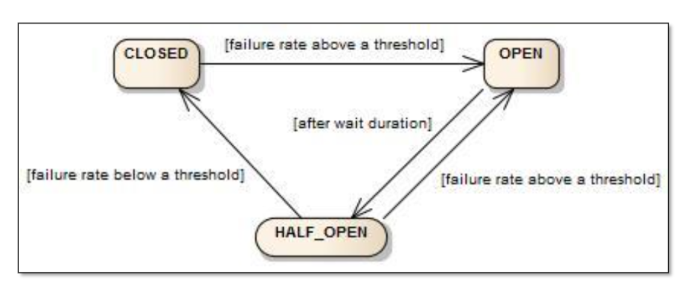
Spring Cloud Resilience4j -Circuit Breaker
Resilience4j provides higher-order functions (decorators) to enhance any functional interface, lambda expression or method reference with a Circuit Breaker, Rate Limiter, Retry or Bulkhead
The circuit breaker has the following 3 states:

Slide 15
Zipkin And Sleuth
Zipkin is a very efficient tool for distributed tracing in the microservices ecosystem.
“docker run -d -p 9411:9411 openzipkin/zipkin”
Sleuth is another tool from the Spring cloud family. It is used to generate the trace id, span id and add this information to the service calls in the headers

Slide 16
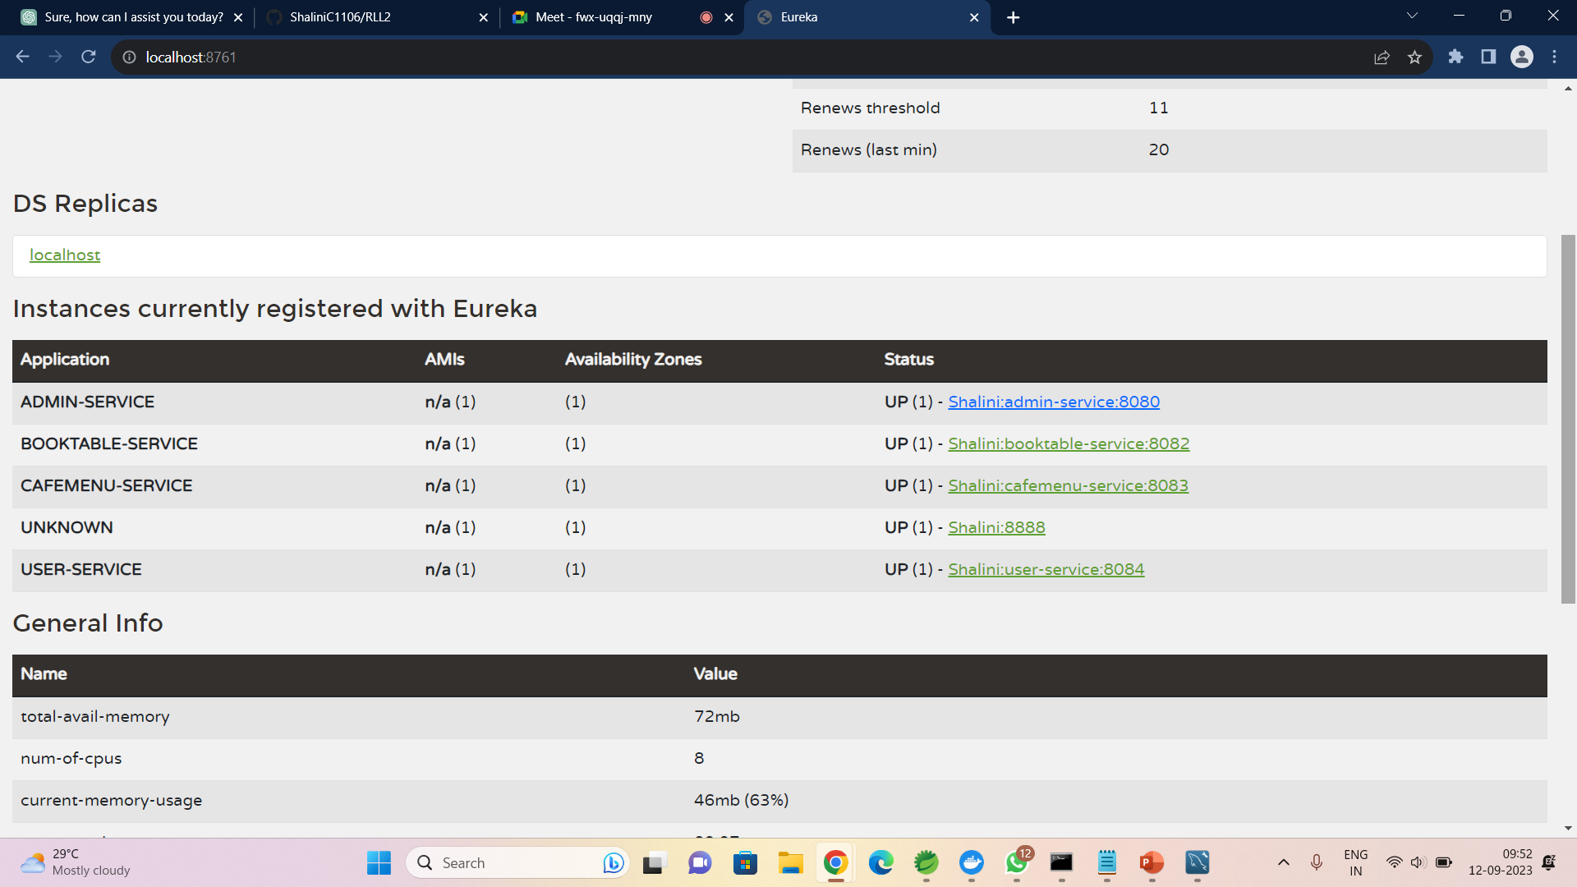
ScreenShots
Eureka Server

Slide 17
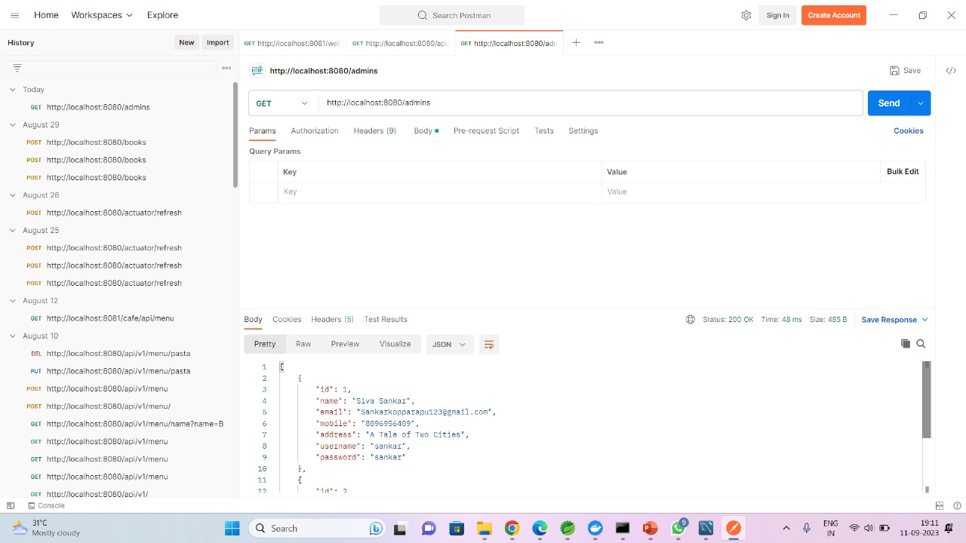
Admin

Slide 18
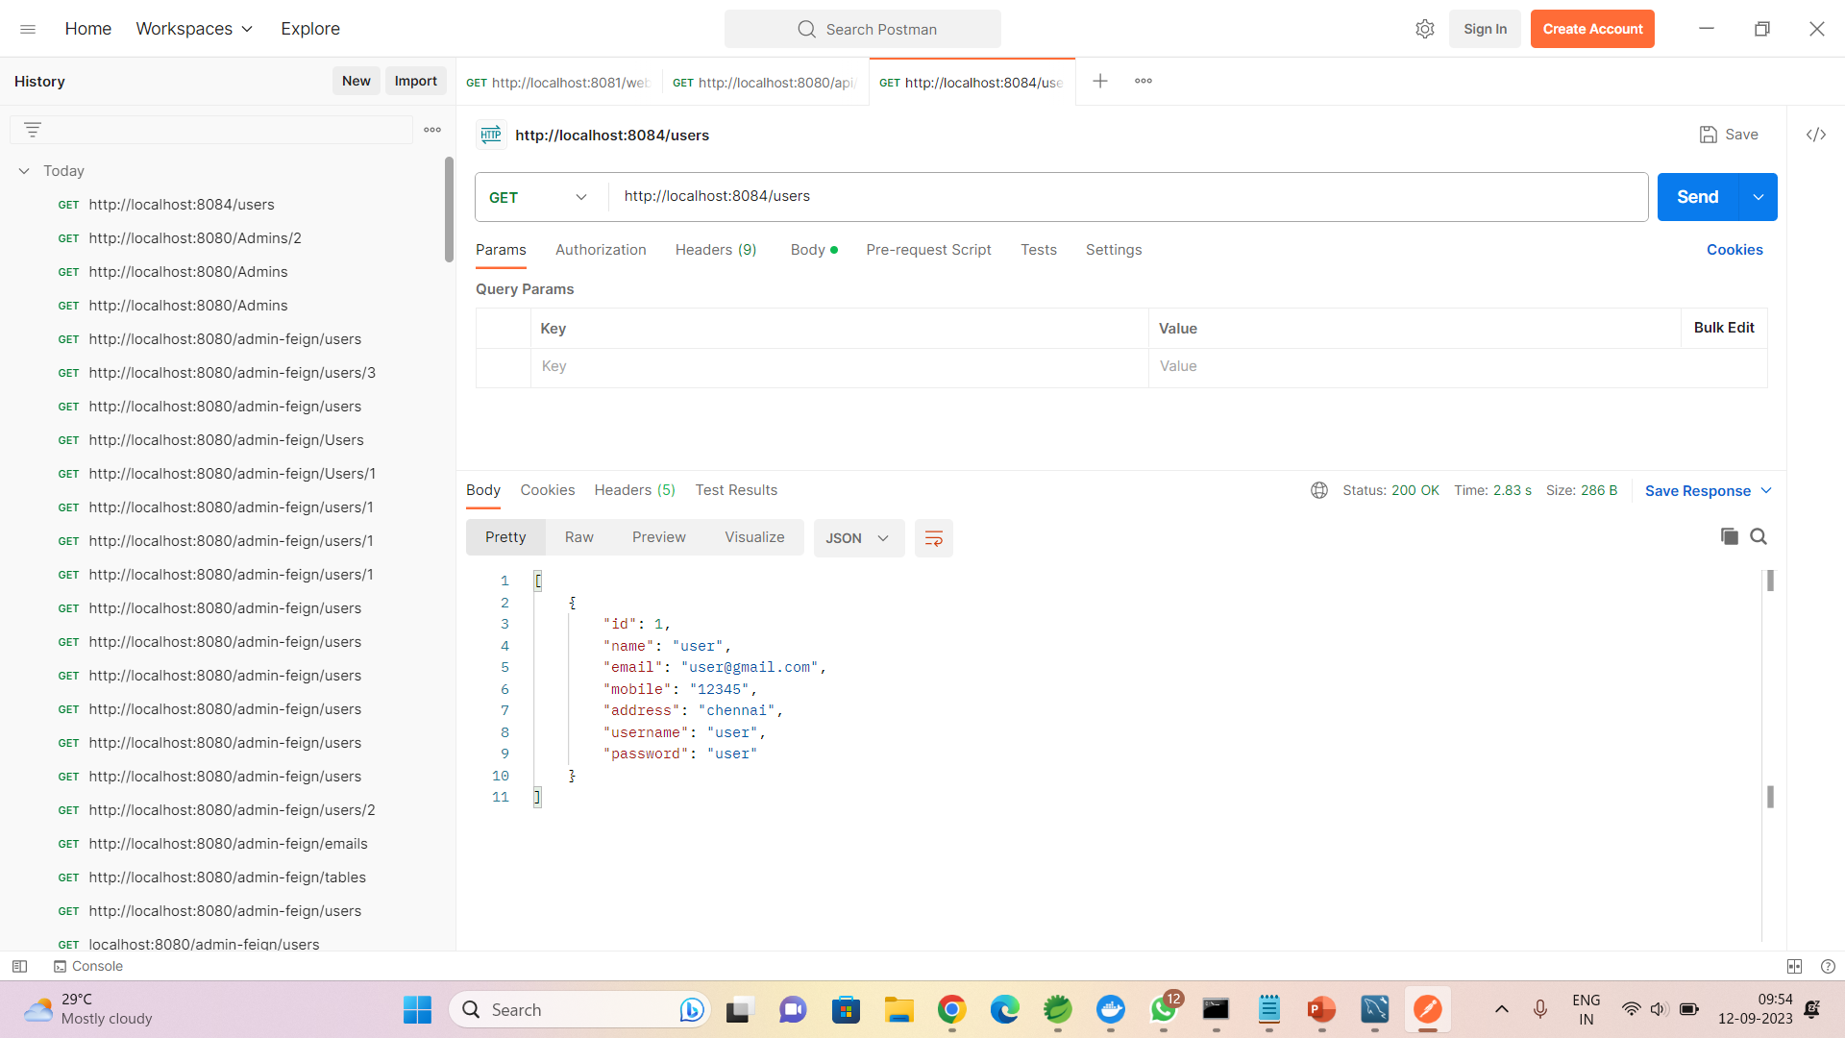
user

Slide 19
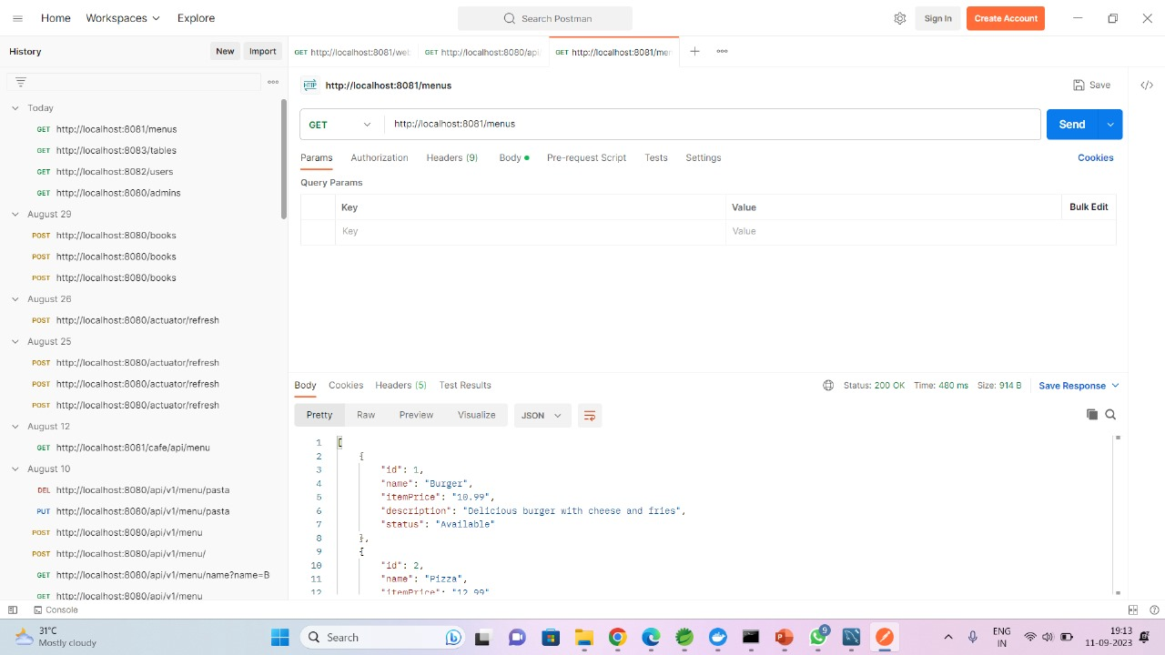
Menu

Slide 20
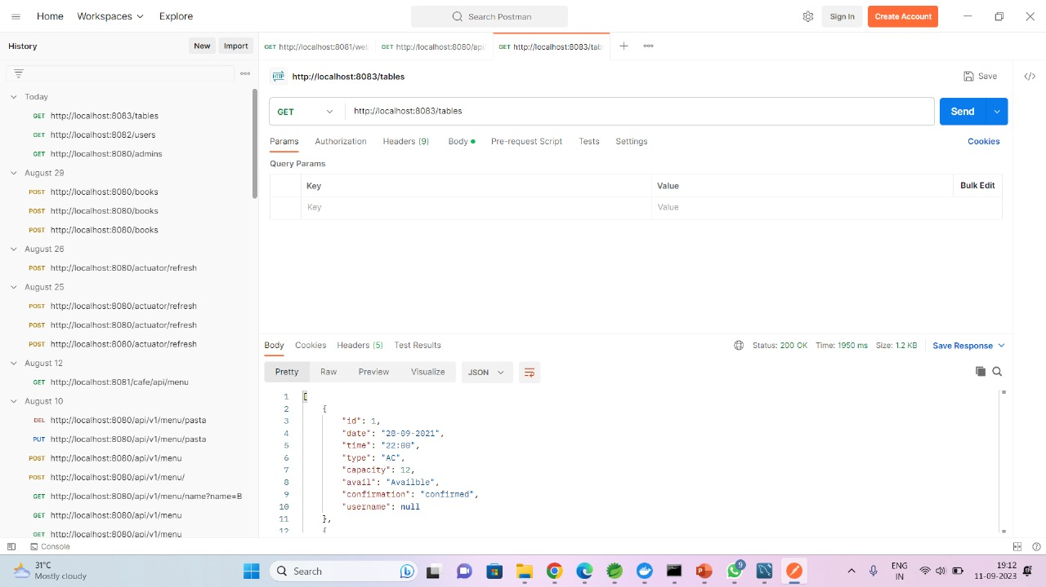
Tables

Slide 21
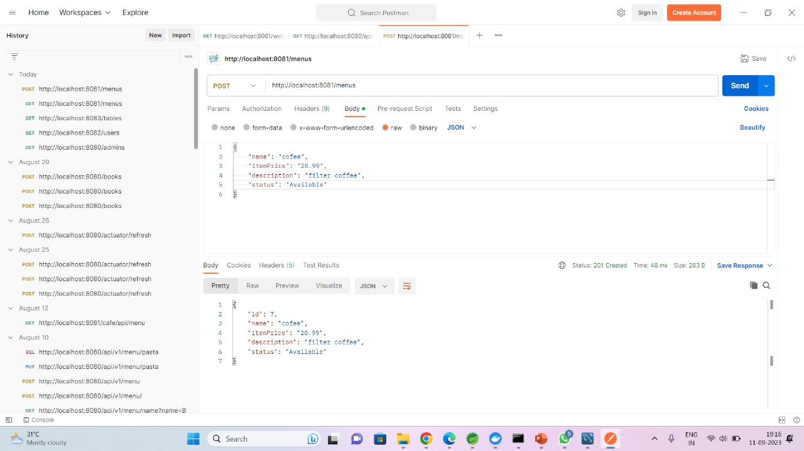
Add a menu

Slide 22
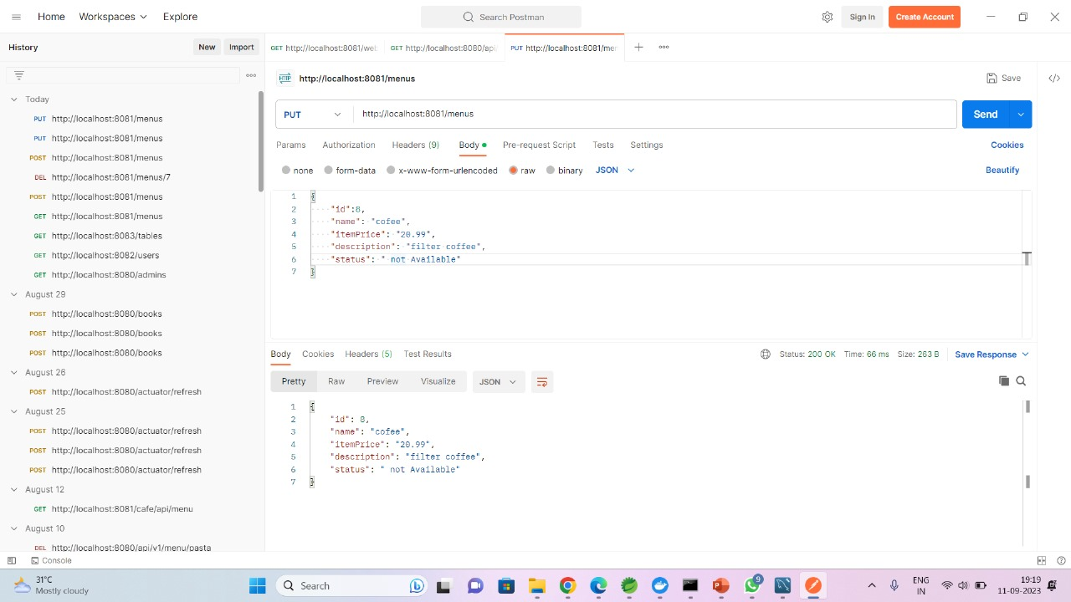
Update a menu

Slide 23
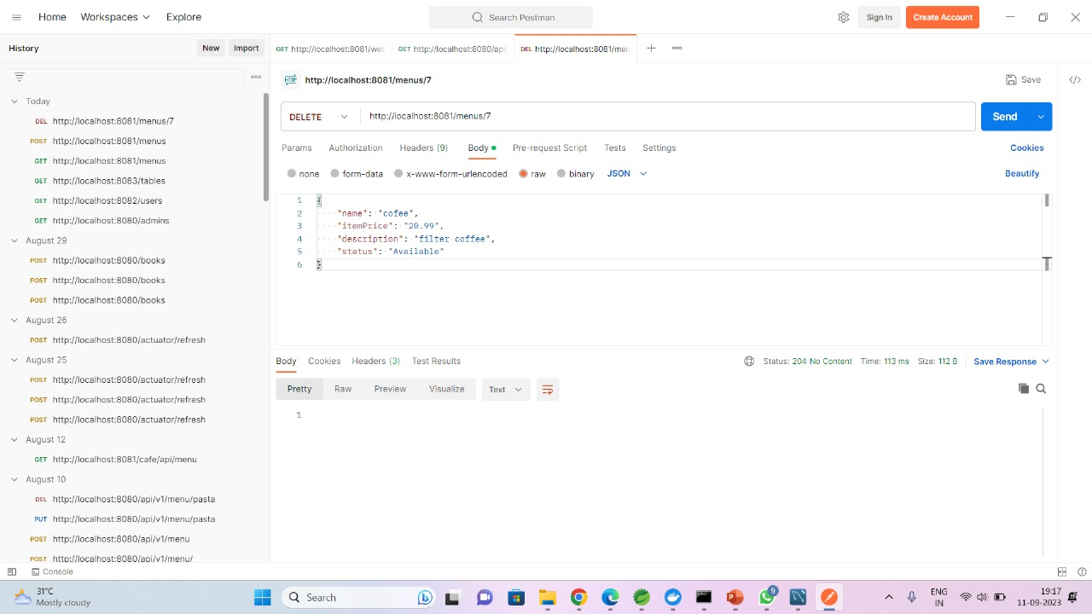
Delete a menu

Slide 24

Menu fallback

Slide 25
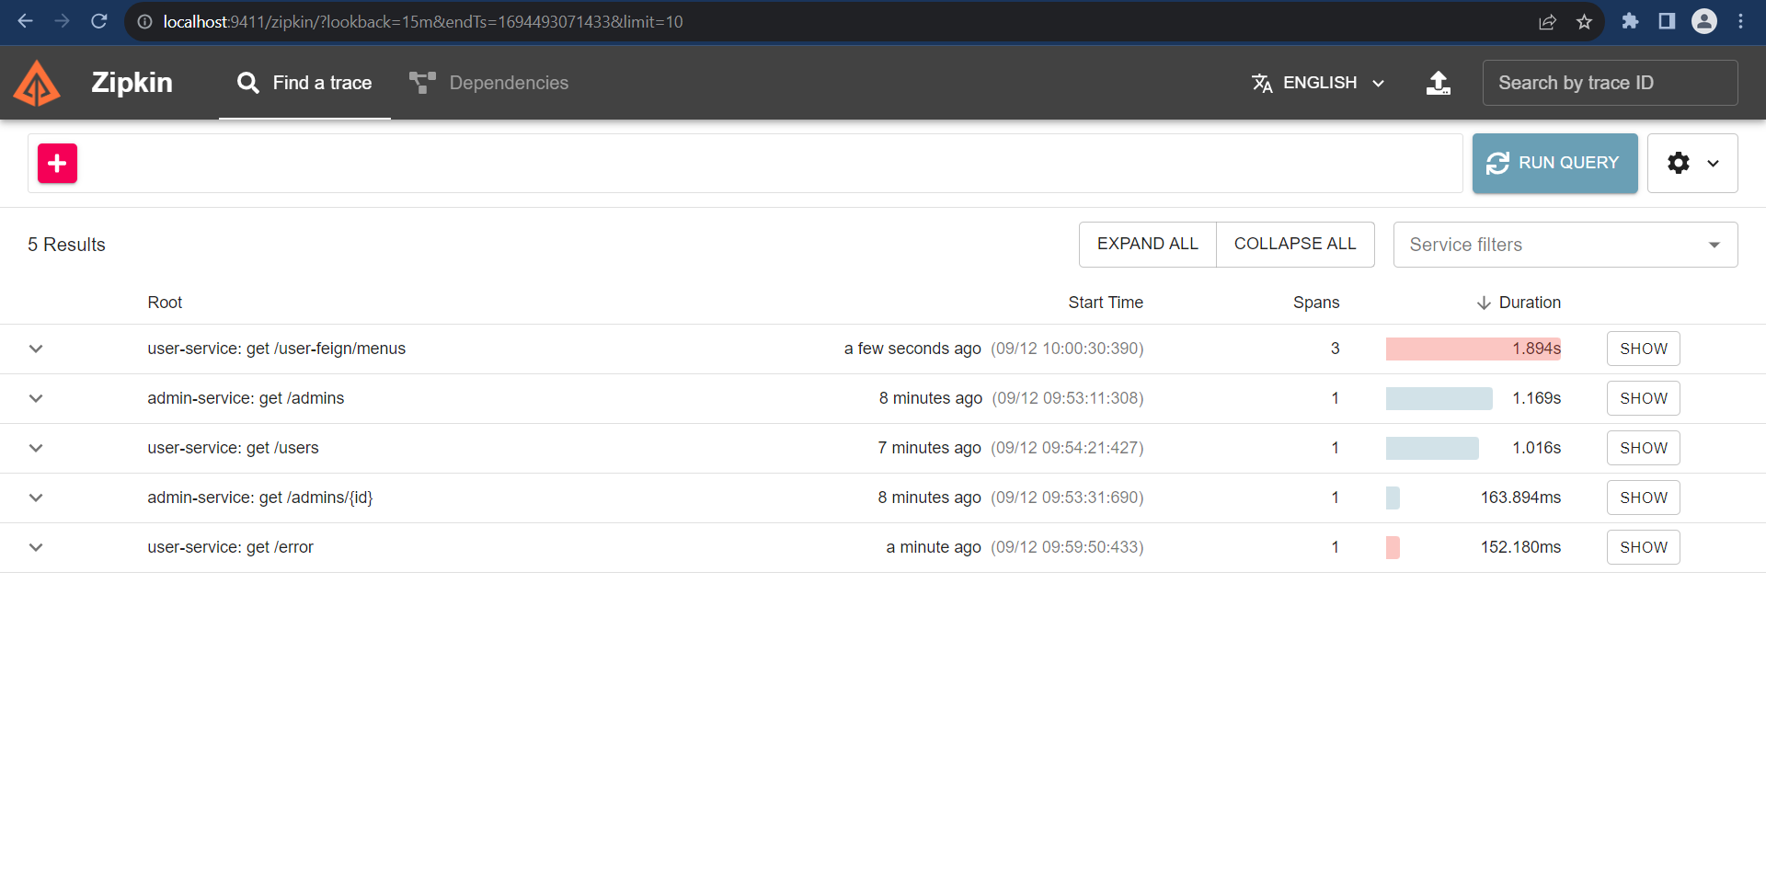
Zipkin Active Servers

Slide 26
Conclusion
In conclusion, the "Online Cafe Reservation" project is a comprehensive and ambitious endeavor aimed at revolutionizing the way cafe enthusiasts interact with their favourite cafes.
By leveraging the power of Java Microservice architecture and a modern tech stack including Spring Boot, Spring Cloud, Spring Data JPA, MySQL, Docker, and more, this project seeks to deliver a robust and scalable backend infrastructure.

Slide 27
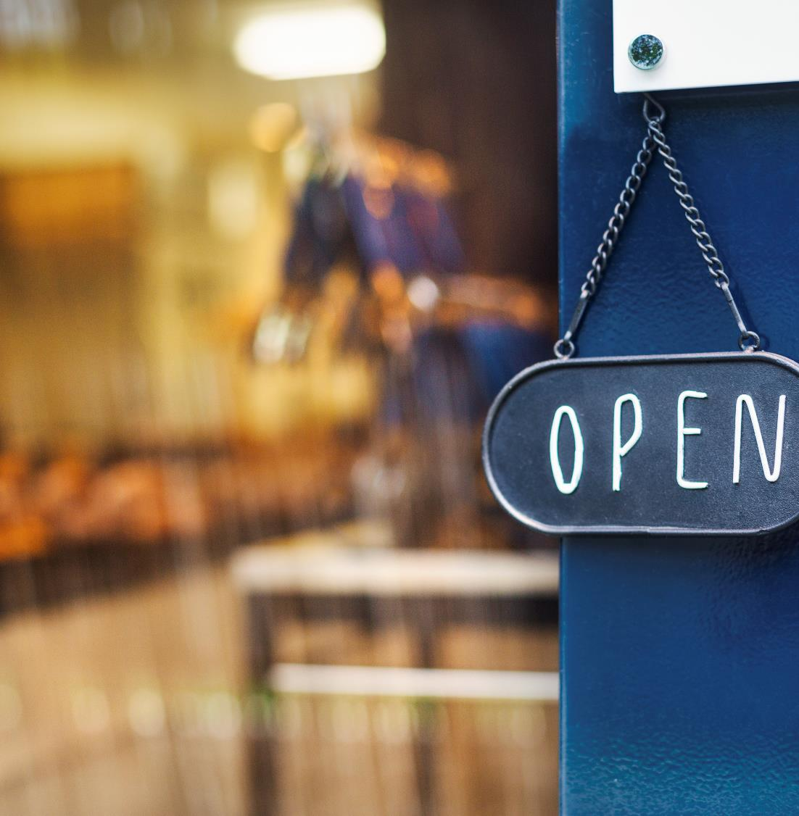
Thank You

